Slide 1
Digital Table Service
Team- 5
Project Guide :
1) Mukund Kakde
2) Mudhur Ingale
Mayuri Mali ( Project Lead)

Slide 2
Abstract
Digital Table Service is the web application that will provide them all this facility. In this application, we create an user interface for hotels, where the entire process is automated from placing an order to billing.

Slide 3
Introduction
Digital Table Service is the web application that will provide them all this facility.
The purpose of the application is to keep records like customer details, food details table-wise. At end of the day, We can measure the actual data .
Customer can track his/her order and after ordering food in mean time they can play game, listen music etc.
They can payment through this application has two options either customer can pay by cash or if customer wants to pay through online then they can pay through default payment gateway.

Slide 4
Problem Definition
Generally in hotels waiter comes and collect order on either notepad or tab. So they are not able to maintain their customer’s records and feedback about their food. Even customer cannot track his/her order and billing details.

Slide 5
Objective
The main objective of this project is to encourage small restaurants to use Digital services. Through this application they can fully handle their order processing digitally.
We can handle billing process , Maintain Billing history and Time Consuming.

Slide 6
SYSTEM REQUIREMENT
Software Specification
Language : JAVA, HTML, CSS.
Framework : Spring, Bootstrap.
Database : MySQL
Operating System : Windows 10
Server : Apache Tomcat(9.0.1)

Slide 7
Hardware Specification
Processor : Intel i3/i5/i7
Processor Speed : 2.9 GHZ
RAM : 4 GB to 8 GB
Hard Disk : 10 GB to 180 GB

Slide 8
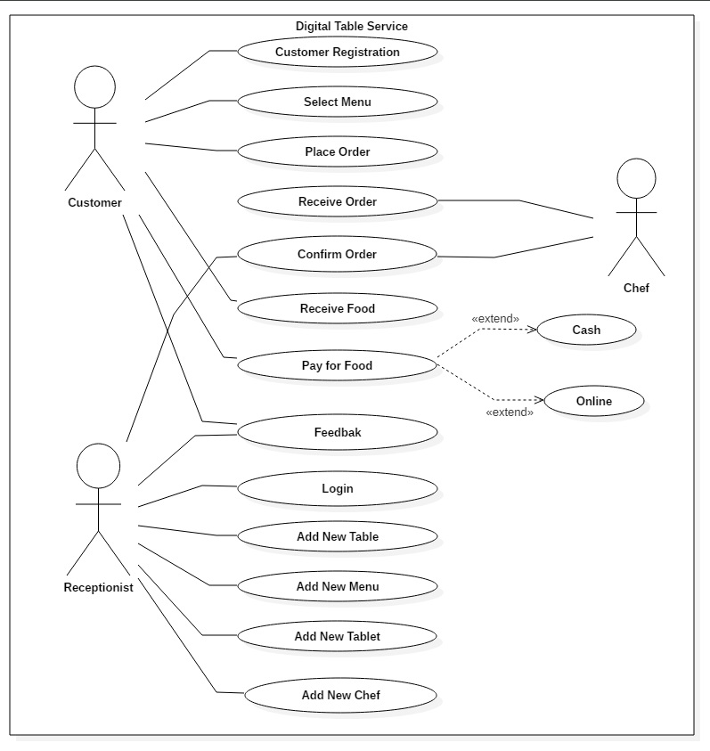
UML Diagram
Use Case :

Slide 9
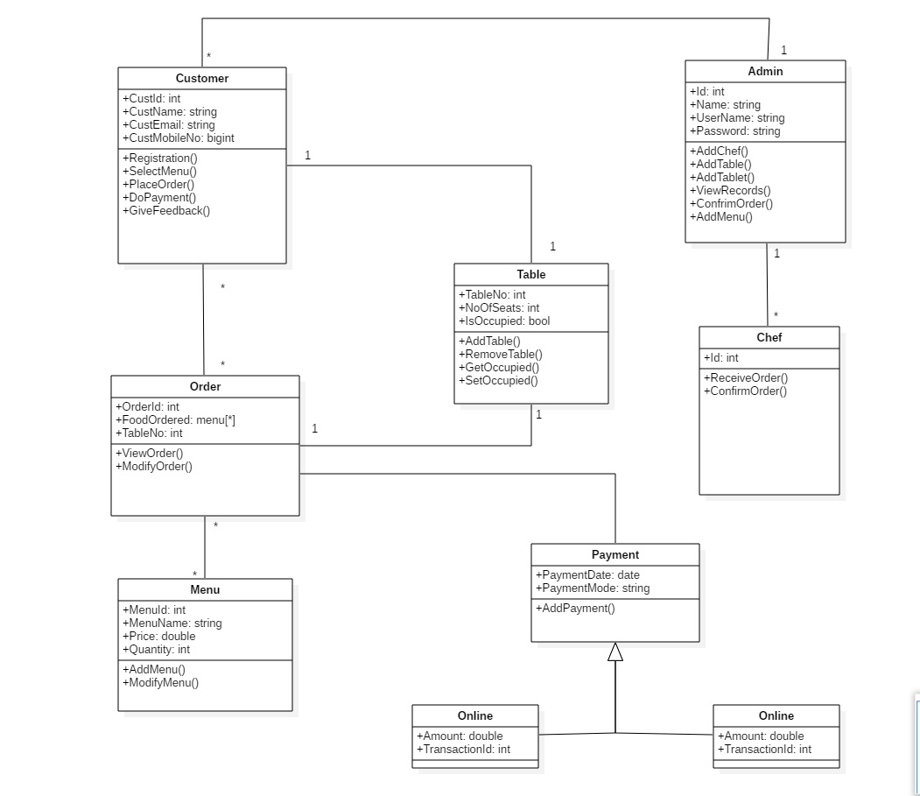
Class Diagram:

Slide 10
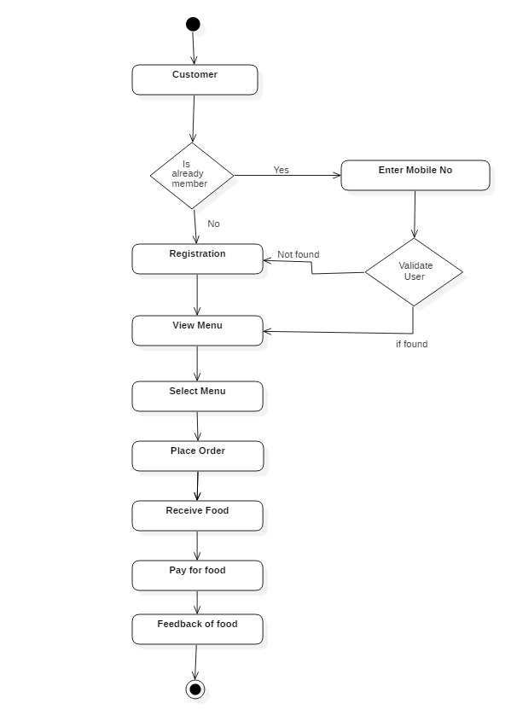
Activity Diagram 1.1

Slide 11
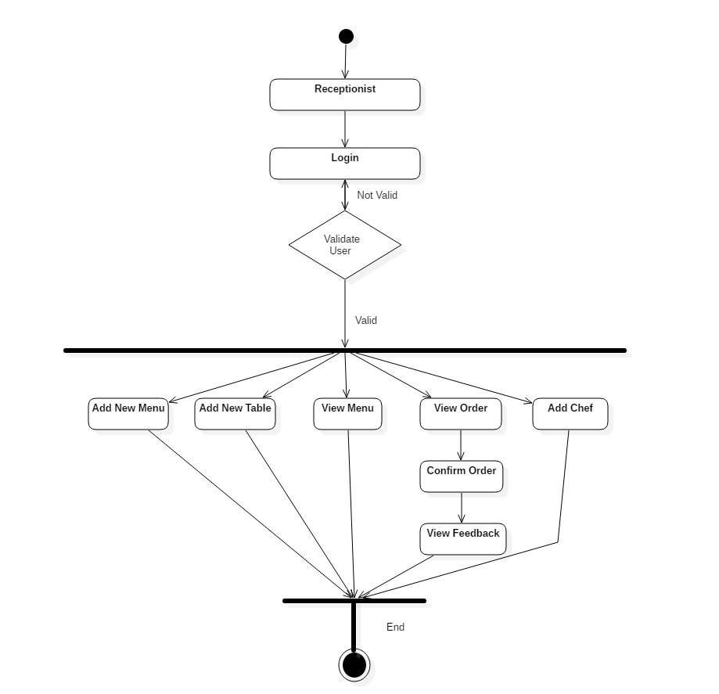
Activity Diagram 1.2

Slide 12
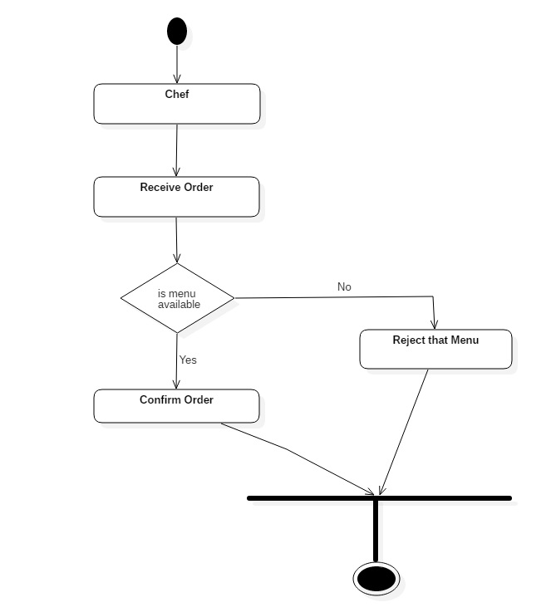
Activity Diagram 1.3

Slide 13
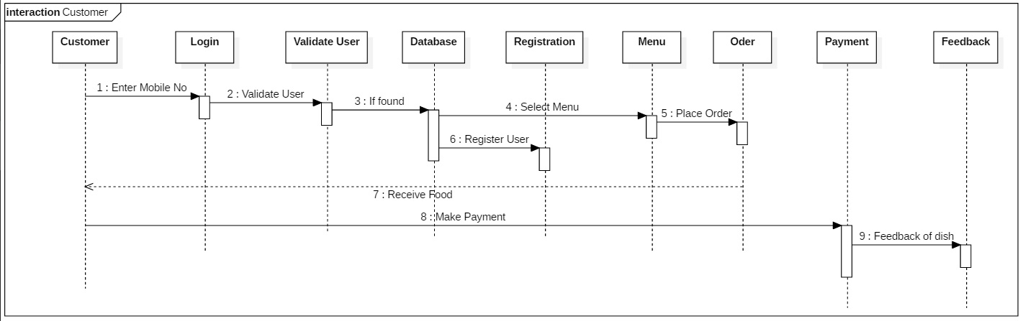
Sequence Diagram 1.1

Slide 14
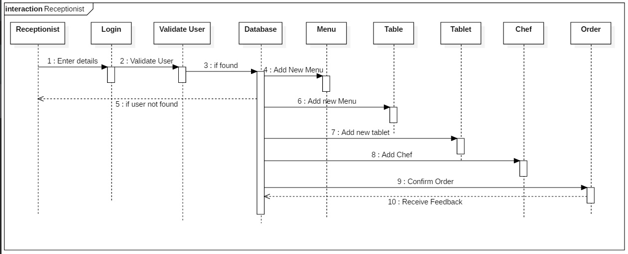
Sequence Diagram 1.2

Slide 15
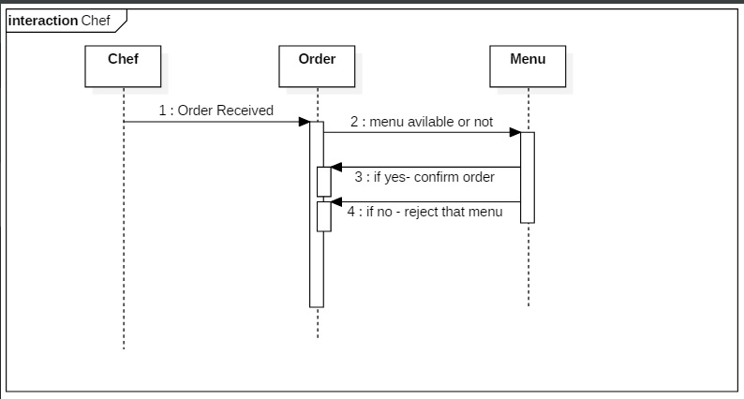
Sequence Diagram 1.3

Slide 16
Future Scope
We can Generate an analysis Report for an Restaurant owner .
We can automatically generate bill audit file(.csv) for tax purpose.
For frequently visiting customer we can send notification regarding to any special offer or discount.
We can store chef’s data according to order he has prepared so that in future any food quality issue arise then hotel owner can view the history.

Slide 17
Thank You…………

